Slide 1
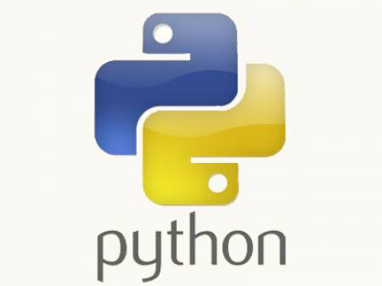
Python Training.....
-- Jeetendra Bhattad

Slide 2
Agenda
History
Popularity ?
Hello Universe – First Python Program
Interpreted, Compiled or Both ?
General guidelines

Slide 3
Introduction - History
Developed by Guido Van Rossum in 1989.
Ranked #1 for 4th continous year by Code-eval, #4th - RedMonk, #5th - GitHub
Named after British comedy group Monty Python.
Major Releases with Dates :-
  1.0 January 1994
  2.0 October 2000
  2.7 July 2010
  3.0 Dec 2008
Latest Releases :-
  2.7.12 June 2016
  3.5.2 June 2016

Slide 4
Reasons for Popularity
Supports Multi-paradigm : Procedural, Object Oriented, Functional etc. Hence also known as General purpose programming language.
Portable : Write Once Run Everywhere.
Readable, reusable, easily maintainable.
Python code is 1/3rd to 1/5th of C, C++ or Java code.
Support Libraries : has prebuilt large collection of libraries with portable functionality.
Python code can invoke C & C++ libraries, easily integrable with Java, .Net components.
Easy to interface with serial port devices, can interact with interfaces like SOAP, XML-RPC etc.
Implemented in C, hence execution is faster.
Open Source.
Continued.....

Slide 5
Popularity continued...
Who all use ?
  Google uses extensively in its web search systems.
  Youtube video sharing service.
  Dropbox storage service.
  Bit-torrent, Google's App Engine etc.
  Intel, Cisco, HP, IBM, Imagination use Python for Hardware testing.
  NASA use Python for scientific programming tasks.
What can be done ?
  System Programming
  GUI
  Internet Scripting
  Database Programming
  Rapid prototyping
  Numeric & Scientific Programming
  Games, Serial port interfacing, Development boards, IoT, xml, json ...everything !!!

Slide 6
Hello Universe !!!
        hello-universe.py
#!/usr/bin/python
print(“Hello Universe !!!”)
How to run ?
  python hello-universe.py or
  chmod +x hello-universe.py & ./hello-universe.py

Slide 7
Only Interpreted Language ?
It is Compiled + Interpreted.
Python Script (hello.py)
Compiled (byte code)
hello.pyc
Interpreted
Python Virtual Machine
(PVM)
Executed
Actual Machine

Slide 8
General Guidelines
# - single line comment.
''' ''' or ””” “”” - multiline comment.
Case-sensitive.
4 space indentation.
vim, Notepad++, PyCharm, Eclipse-PyDev plugin etc editors can be used.
Pylint, pep8 tools can be used to enforce coding standards.
pip install to install 3rd party python packages / libraries.

